Slide 1

Infectious Disease Simulation
Mattheau Casey, Mingjie Wang, Lammar Carey, and Jobane Moreno

Slide 2
Problem Statement
Using just the basic implementation of the disease simulation, discover trends in data and analyze how disease spread can be reduced
Develop some policies to test in future applications of the experiment
Given abstraction of simulation environment, our goal is to analyze data with the purpose of developing policies for a black-box system

Slide 3
Specifications and Rules Followed
Create a 20 x 20 grid with 240 agents
At each time step, all agents move to a random, valid position, in a random order.
After every individual move, if a sick agent is orthogonally adjacent to any healthy agents, spread the disease to all the healthy agents.
End the simulation once there are no healthy agents.

Slide 4
Demonstration

Slide 5
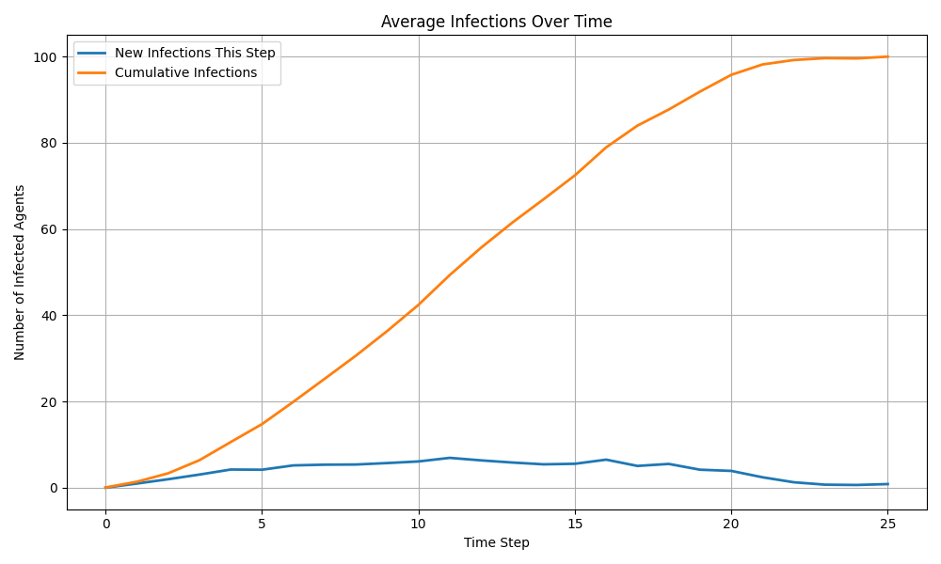
Results - 10 runs

Slide 6
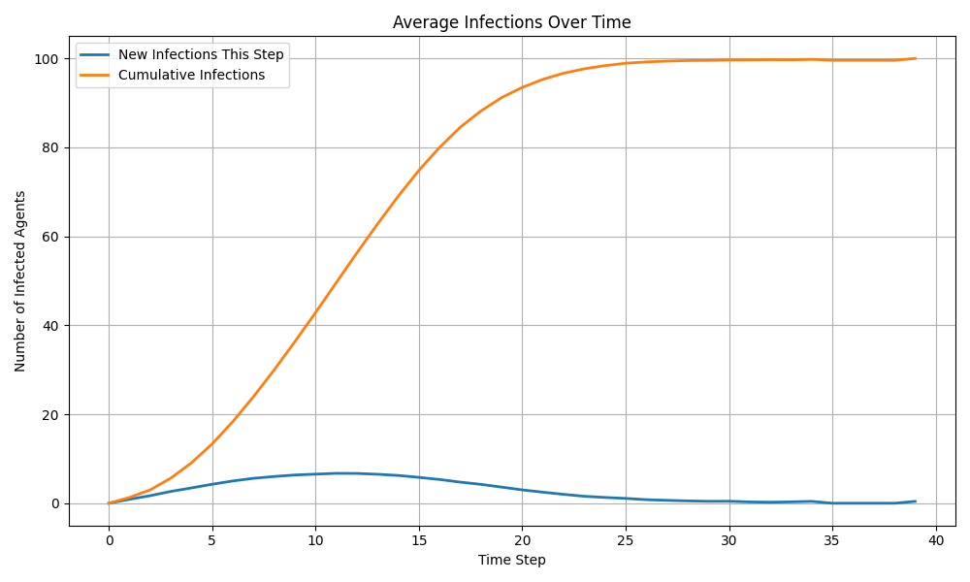
Results - 1000 runs

Slide 7
Observations
Most simulations ended by turn 30, some outliers went significantly farther out to nearly turn 40
Simulations that made it past turn 30 all had starting positions hugging a wall, or started near one of the corners
Simulations that ended before turn 20 were nearly always starting closer to the center

Slide 8
Future Policies and Experimentation
What happens when all agents are encouraged away from the center? What about only infected agents?
Social distancing, quarantine infected, etc.
Implementing Death and Immunity rules
Exploring more depth with simulation and policies that assume little to no information on whether agents are infected

Slide 9
Thank You!

